Slide 1
VIRTUAL LIBRARY
Submitted by Guided by
1.Subramanian S (230701349) Subamalai R
2.Tejaswin G (230701359) Assistant professor of CSE dept
3.Praveenraj M (230701396) Rajalakshmi engineering college

Slide 2
1.INTRODUCTION
A mobile-based library management system designed using Flutter and Firebase. The system enables students and staff to efficiently browse, borrow, and read both e-books and physical books. With integrated role-based access control, users experience a personalized interface while administrators gain access to advanced management tools.
This solution improves traditional library operations by offering real-time updates on book availability, supporting remote access to a wide range of digital resources, and minimizing manual errors. It enhances user convenience, optimizes resource utilization, and lays the groundwork for scalable, data-driven library services in academic institutions.

Slide 3
2.PROBLEM STATEMENT
Traditional library systems rely heavily on manual processes for issuing and returning books, which often leads to long wait times, inefficiencies, and human errors. Students struggle with the lack of real-time visibility into book availability, resulting in repeated visits or missed opportunities to access important resources.
Moreover, these systems typically lack integration with digital content like e-books, and offer limited administrative control. There is no centralized platform for managing both physical and digital resources, making it difficult for librarians and faculty to keep track of book inventories, user activity, and timely access.

Slide 4
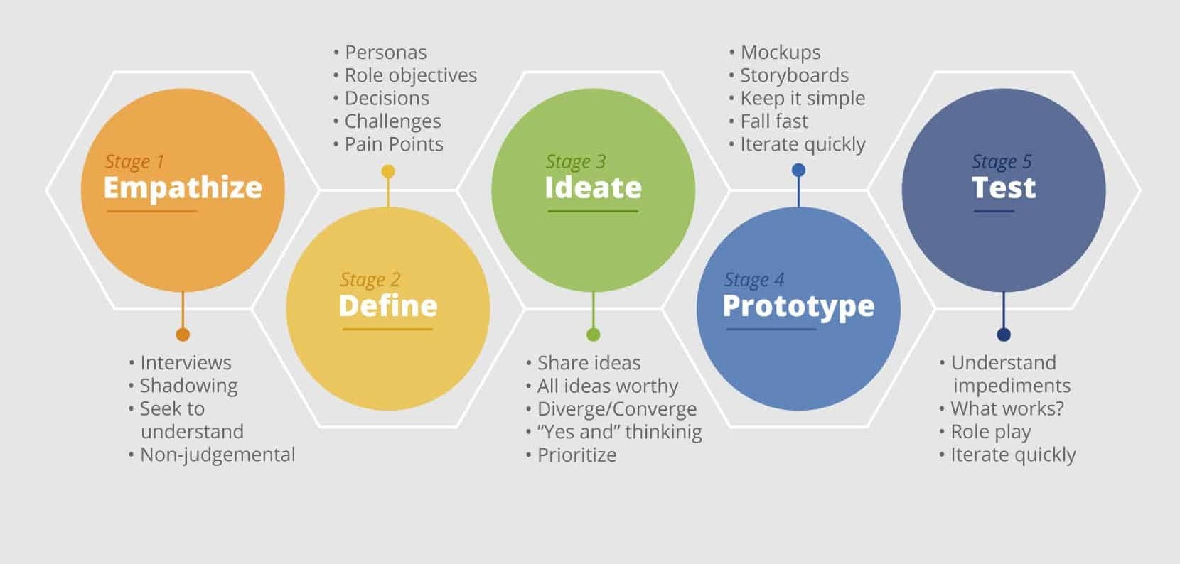
3.STANFORD DESIGN THINKING MODEL

Slide 5
Empathize: We conducted interviews with students and librarians to understand their day-to-day experiences, frustrations, and expectations from a library system. This helped us gain firsthand insights into the user’s needs.
Define: From these discussions, we identified key problems such as delays in book issue/return, lack of visibility into available books, and the complete absence of digital access to e-books and records.
Ideate: Based on the defined challenges, we brainstormed multiple solutions and finalized the idea of a mobile app that allows real-time tracking of book availability and provides seamless digital access to library resources.
Prototype: We developed a working prototype using Flutter for the front end and Firebase for backend services, including authentication, database, and storage. The prototype includes essential features like login, browsing, borrowing, and admin controls.
Test: The prototype was deployed among a group of college students who tested its functionality. Their feedback helped us refine the user interface and ensure the system was intuitive, responsive, and practical for regular use.

Slide 6
4.Features of the Project
Secure User and Admin Login: The system uses Firebase Authentication to ensure secure sign-in for both students and administrators. Role-based access control ensures users see only the features relevant to their role.
Category-Based Browsing (CSE, EEE, Core, Projects): Books are organized into clearly defined academic categories, allowing users to easily browse and locate materials specific to their department or coursework.
E-Book Reading Functionality: Users can directly access and read e-books within the app, eliminating the need for external downloads. The reading interface is optimized for mobile use with smooth navigation.
Cart and Checkout System for Physical Books: Students can add physical books to a cart and proceed to a checkout request, mimicking the familiar e-commerce experience. This system helps reduce wait times and improves book lending management.
Admin Panel for Dynamic Book Updates: Admins have a dedicated dashboard to add, update, or delete book records in real-time. This feature streamlines library inventory management and keeps the system up to date without manual paperwork.

Slide 7
5.Pain Points Identified
Delays in Book Issue/Return: Students often experience long wait times due to the manual book issuing process. Queues at the library counter and dependency on staff availability contribute to inefficiency and user frustration.
Lack of Real-Time Data: There is no instant visibility into whether a book is available, issued, or reserved. Users must visit the library physically or rely on outdated logs to know the status, leading to wasted effort and time.
Manual Error-Prone Record-Keeping: Traditional libraries rely on physical registers or spreadsheets, which are susceptible to human error. Mistakes in book tracking or user logs can lead to misplaced books, disputes, or inventory mismatches.
No Support for Remote Access: Students cannot check availability, reserve, or read e-books from home. The absence of a digital interface restricts access to library resources outside library hours or off-campus locations.

Slide 8
6.Technologies Used
Frontend – Flutter (Dart): The mobile application is built using Flutter, a modern UI toolkit by Google. It enables fast, cross-platform development with a responsive and visually appealing interface. Dart is the programming language used with Flutter.
Backend – Firebase Authentication: Firebase Authentication manages secure login and user identity verification. It supports email/password login and ensures role-based access for admins and regular users.
Database – Cloud Firestore: A scalable, real-time NoSQL database used to store and retrieve book details, user activity, categories, and borrowing history. It enables instant updates across all users without manual syncing.
Storage – Firebase Cloud Storage: Used to store e-book files and any other media resources. It supports secure uploads/downloads and integrates easily with Firestore records for linking digital content.
Payment Integration – Razorpay (for payments): Razorpay is considered for future integration to enable online payments for late fees or physical book rentals. It provides secure, in-app payment options.

Slide 9
7.Comparative Analysis
Feature | Existing Library Model | Proposed Digital Library System
Book Issue Process | Manual entry in registers or spreadsheets | Real-time request and update via mobile app
Book Availability Info | Only known on physical visit or by asking staff | Live availability status shown in app
E-Book Access | Not available or very limited | Seamless in-app reading of e-books
Admin Controls | Basic inventory update, mostly offline | Real-time add/edit/delete through admin dashboard
Remote Access | No remote access to catalog or borrowing | Fully accessible from anywhere via mobile device

Slide 10
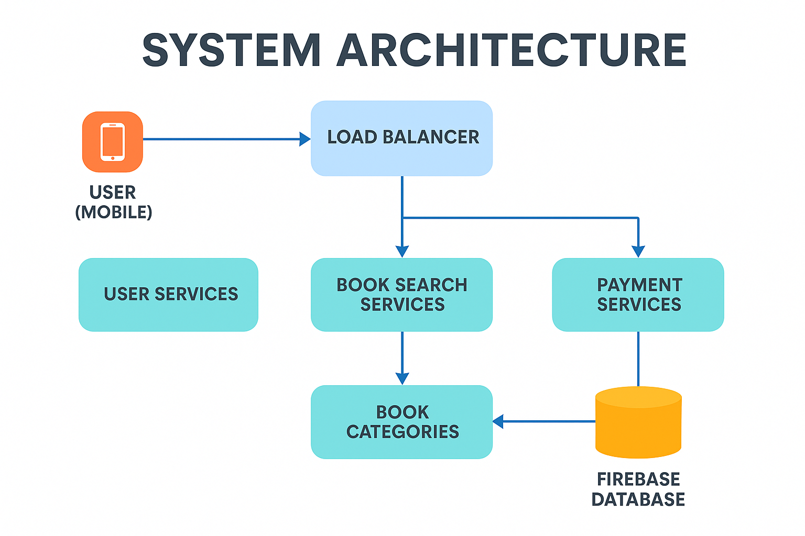
8.Proposed Method (Design Thinking Approach)

Slide 11
System Architecture:
The architecture of the Virtual Library system adopts a modern client-server architecture optimized for scalability and cross-platform functionality. The client side is built with Flutter, enabling high-performance, natively compiled apps for Android and iOS from a single codebase, with tailored interfaces for users and admins—supporting features like category browsing, e-book viewing, carting, and admin management tools. The backend uses Google Firebase as a Backend-as-a-Service (BaaS), with Firebase Authentication for secure, multi-method logins, and Cloud Firestore for real-time, scalable data management of users, books, authors, categories, and borrowing records.

Slide 12
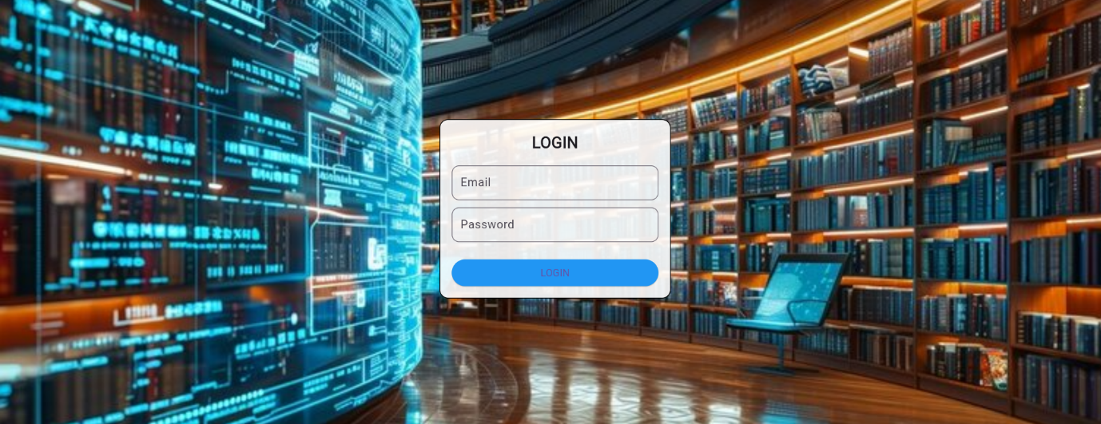
Login page:
9.Prototype developed
The login page provides role-based login with validation and redirection to respective dashboards.

Slide 13

Home page:
Home page displays categories like CSE Books, EEE Books, Core Subjects, and Project Reports.

Slide 14
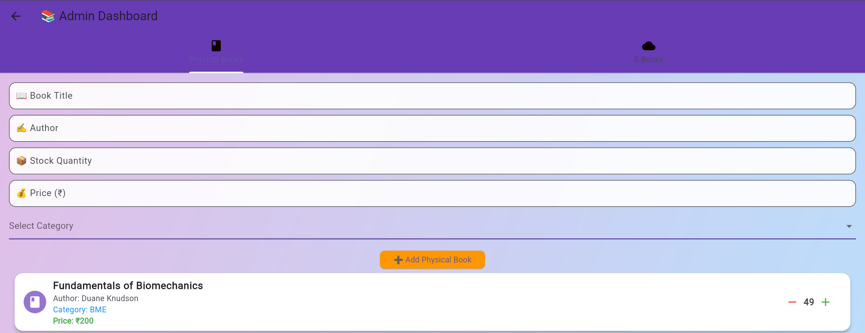
Admin dashboard:
Admin dashboard helps admin to manage book categories, verify uploads, and view analytics.

Slide 15
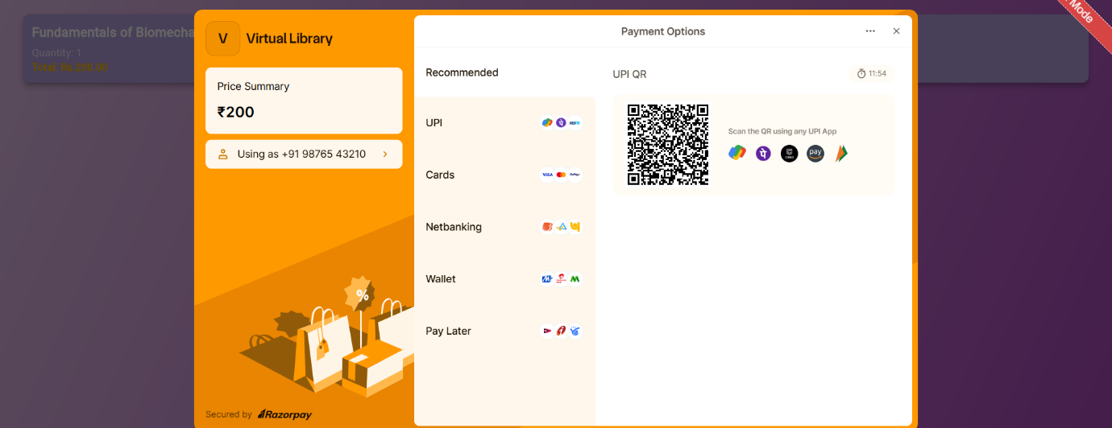
Payment page:
Payment page is integrated with razorpay payment gateway a secure payment gateway integration for books or reports.

Slide 16
10.Target audience benefitted
Students: Easy and Instant Access to Resources
Immediate access to digital books, research papers, and academic journals anytime, anywhere.
Faculty: Faster Resource Sharing
Effortless distribution of course materials, reference books, and scholarly articles to students.
Admins/Librarians: Better Control and Monitoring
Centralized management of library resources with detailed tracking of usage and borrowing patterns.
Institutions: Efficient Digital Library Operations
Cost-effective library management by reducing the need for physical storage and maintenance.

Slide 17
11.Conclusion
The Virtual Library project enhances how academic institutions manage and distribute learning resources digitally, addressing the lack of a unified, student-focused online library. Traditional libraries are limited by physical access, whereas this platform offers centralized, structured content availability. Rooted in the Design Thinking framework, the project began by identifying real user challenges through empathetic research, including interviews and feedback. Key issues uncovered included difficulty in locating categorized academic materials and inefficient educator upload workflows. These insights were transformed into clear problem statements, guiding the system’s design goals and functionality toward a more accessible, user-centered experience.

